Slide 1
Digital Signatures and Certificates
Information SECURITY

Slide 2
Digital Signature

Slide 3
What is digital signature
A digital signature, which should not be confused with a digital certificate, is a mathematical technique used to validate the authenticity and integrity of a message, software or a digital document.
A digital signature, as opposed to a traditional signature, is not a name but two “keys” or sequences of separated characters. It applies cryptographic measures to the content of a message or document in order to show the following to the message’s recipient:
that the sender of the message is real (authentication);
that the sender cannot deny that they sent the message (non-repudiation);
that the message has not been altered since it was sent (integrity).

Slide 4
A digital signature is therefore a key part of the advanced electronic signature and qualified electronic signature, but not of the simple electronic signature. A simple electronic signature would be, for example, a personal identification number (PIN) entered at a cash machine or clicking on “accept” or “do not agree” on a “terms and agreements” electronic contract. This type of electronic signature cannot attribute the electronic signature of a signatory to a specific signatory, therefore, it is does not have the same features as a digital signature.
A digital signature is legal, but its aim is not to attest to the signatory’s willingness like an electronic signature, but just to encrypt the data of a document to give it greater security.
Also a digital signature can be used for a wider range of file types, such as videos, sound, music, etc., making it more versatile than the traditional paper signature.

Slide 5
How it works
The first thing we should know if we want to understand what a digital signature is, is the term hash. The hash functions are algorithms that are created from an input (be it text, a password or a file for example) an alphanumerical output of usually a fixed length that represents an overview of all the information that it has been given. Meaning, the data input creates a chain that can only be created again with the same data. To create a digital signature, the signature software creates a one-way hash of the electronic data that needs to be signed. The private key is used to encrypt the hash. The encrypted hash together with other information is the digital signature.
Any change to the data, even changing or removing just one character will result in a different value. This allows others to validate the integrity of the data by using the signatory’s public key to decrypt the hash.

Slide 6
How it works
If the decrypted hash coincides with a second hash calculated from the same data, it proves that the data has not changed since it was signed. If the two hashes do not coincide, the data has been altered in some way (integrity) or the signature was created with a private key that does not correspond to the public key presented by the signatory (authentication).
The digital signatures make it difficult for the signatory to deny having signed something (non-repudiation), assuming that their private key has not been compromised, as the digital signature is unique both for the document and the signatory, and they go together.
A digital certificate, an electronic document that contains the digital signature of the certificate authority, links a public key with an identity and can be used to verify that a public key belongs to a specific person or entity.
Digital signatures are widely used to test the data’s authenticity and integrity and non-repudiation of communications and transactions made online.

Slide 7
Reasons to consider using the digital signature process
The most common concerns that people and organisations have with paper documents are: is the person that signed the document the person they say they are? How can I check that the signature is valid and has not been forged? How can I check if the document has been changed?
As well as making business processes easier and preventing the falsification of messages and key documents, using a digital signature provides additional validation benefits. When you need a guarantee that a message or attached document has not been altered during the transfer, a digital signature helps to avoid unknown alterations going unnoticed.
If the digitally signed content is altered the signature will be invalid, which will notify the sender and the recipient of an infringement. The cryptographic features will avoid a new and valid signature being produced for this message.
When non-repudiation is provided, the message’s sender cannot deny the message’s digital signature at a later date. The recipient or someone who obtains unauthorised access to the message cannot create a false signature.
Most of the non-repudiation methods provide a time stamp that cannot be altered and provide evidence of the digital signature in case the private key has been compromised or revoked.

Slide 8
Digital Signature
Message Authentication protects two parties, who exchange messages, from any third party
Integrity protects from data alteration
Confidentially protects message from opponents

Slide 9

Digital Signature
Suppose
J sends an authenticated message to M
M may forge a different message and claim that it is from J. Example: electronics funds transfer
J can deny sending the message. Example: Electronics email message

Slide 10
Digital Signature
Digital signature is analogous to the handwritten signature
Properties
Verify the author and the date and time of the signature
Authenticate the contents at the time of the signature
Be verifiable by third parties

Slide 11
Requirements of DS
Must be bit-pattern and depends on message
Must send some unique info to avoid forgery & denial
Must be easy to produce
Recognition and verification should be easy
Should be computationally infeasible to reproduce
A copy should be retained in DS storage

Slide 12
Types of DS Functions
There are two types of Digital Signatures
Direct Digital Signature
It only involves the communicating parties like sender and receiver
Arbitrated Digital Signature
It involves an arbitrator to authenticate the sender and receiver

Slide 13
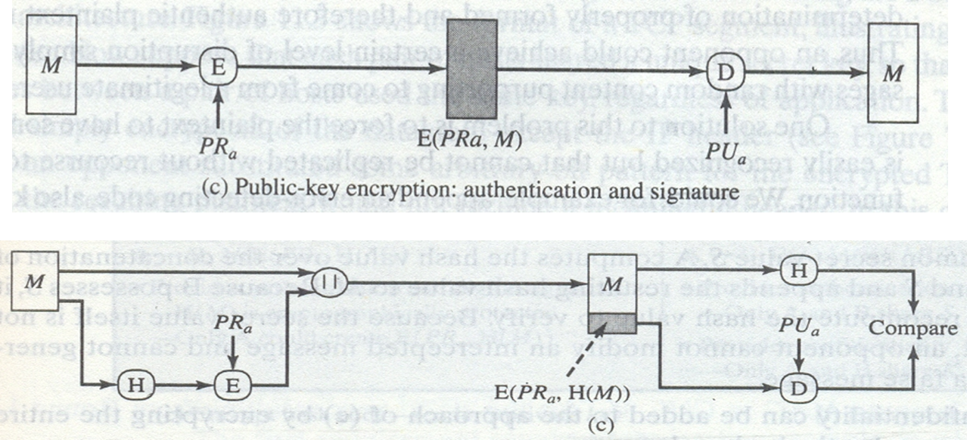
Direct Digital Signatures
In this scheme the concept of Public Key Encryption is used
The message may be encrypted with the sender’s private key
The hash code of a message is encrypted by the sender’s private key

Slide 14
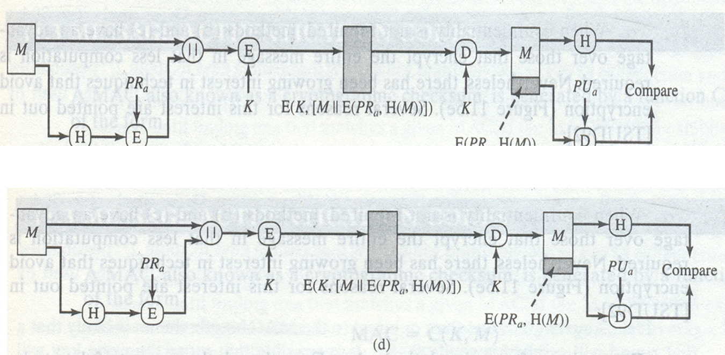
Direct digital Signatures
Confidentiality can be provided by further encrypting with the entire message and signature with receiver’s public key or symmetric key

Slide 15
Direct Digital Signatures
Weaknesses of DDS
The validity depends on security of sender’s private key
Sender can deny sending a message and claim that the private key was stolen
The key actually is stolen

Slide 16
Arbitrated Digital Signature
The arbiter can be used as a mean to over come the weaknesses of DDS
Sender sends message to Arbiter
Arbiter verifies it through multiple tests
Then Arbiter sends the message to receiver with the indication that it has been verified
Arbiter plays a sensitive and crucial role

Slide 17
Arbitrated Digital Signature
Conventional Encryption, Arbiter sees the message
X->A: M || E_{KXA} [ID_{x} || H(M) ]
A->Y: E_{KAY}[ ID_{X} || M || E_{KXA}[ID_{X} || H(M)] || T ]

Slide 18
Arbitrated Digital Signature
Conventional Encryption, Arbiter can not see the message
X->A: ID_{x} || E_{Kxy} [M] || E_{Kxa} [ID_{x} || H (E_{kxy}[M])]
A->Y: E_{Kay}[ ID_{x} || E_{Kxy}[M] || E_{Kxa}[ID_{x} || H(E_{kxy}[M])] || T ]

Slide 19
Arbitrated Digital Signature
Public Key Encryption, Arbiter cannot see the message
X->A: IDx || EKrx [IDx || EKuy (Ekrx [M])]
A->Y: Ekra[ IDx|| Ekuy [ Ekrx[M] ] II T ]

Slide 20
Arbitrated Digital Signature
Advantages:
No information is shared among the parties
No incorrectly dated message can be sent
Contents of the message from X->Y is secret

Slide 21
Digital Signature Standard
Originally proposed in 1991
Revised in 1993
NIST has published FIPS 186
DSS used Secure Hash Algorithm
In 2000, FIPS 186-2 was published

Slide 22
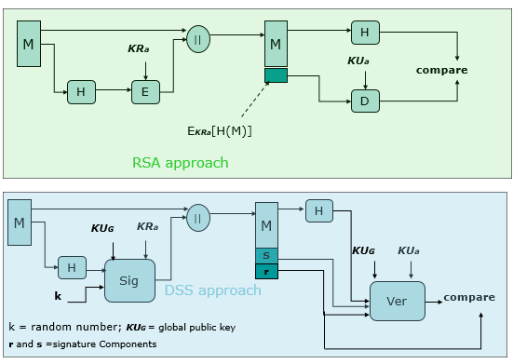
DSS

Slide 23
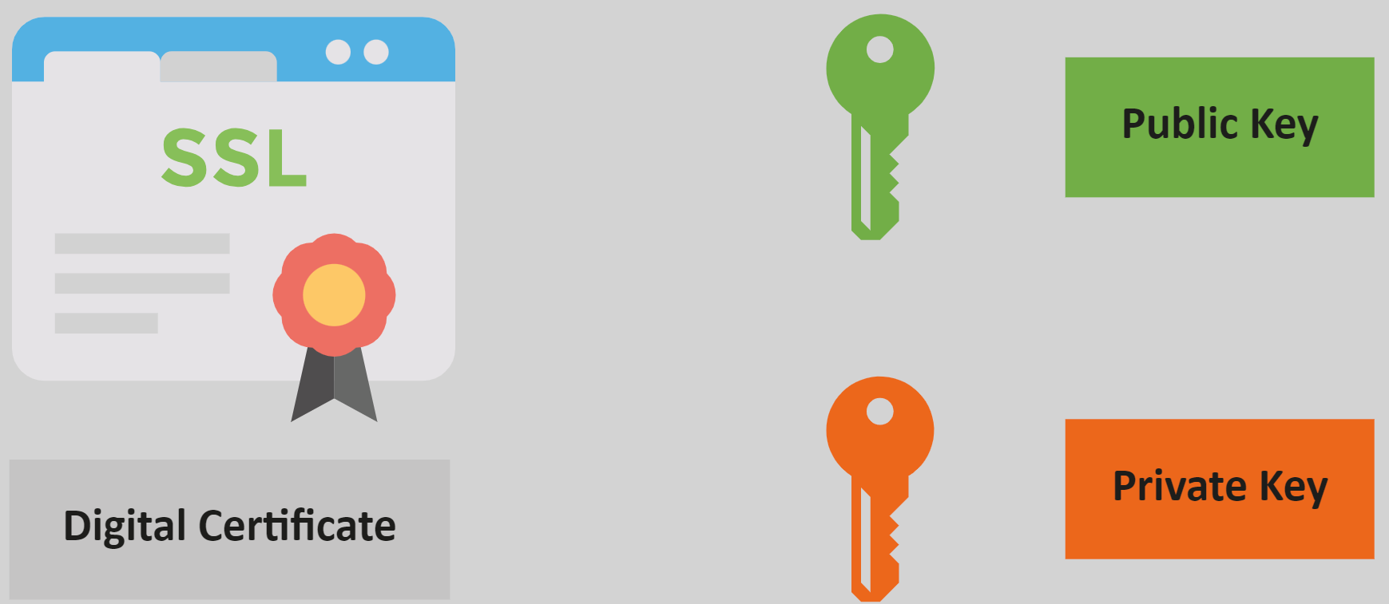
Certificates
Notes:
A Digital Certificate is an electronic file that is tied to a cryptographic key pair and authenticates the identity of a website, individual, organization, user, device or server. It is also known as a public key certificate or identity certificate. The certificate contains the subject, which is the identity piece, as well as a digital signature.
They are the foundation to implementing Public Key Infrastructure (PKI) security
TLS/SSL certificates: The TLS/SSL certificate is used to secure communications between a computer and the server, and it is hosted by the server. When a client computer seeks to access the server, the server will present the digital certificate to prove that it is authentic and the desired destination.
Client certificates: This is a form of a digital ID that can identify one machine to another — a specific user to another user. This can be used to allow a user to access a protected and secure database and also for email.
Code signing certificates: This type of digital certificate involves software or files. The publisher or developer of software will sign it to validate its authenticity to users downloading it.

Slide 24
What Is a Digital Certificate?
A digital certificate, also called public key infrastructure (PKI) certificate, is an electronic form of authentication and identification that comes in the form of a small file. It uses mathematical formulas to handle a variety of functions:
Assert the identity of the certificate holder (organization, individual, device, etc.).
Encrypt and decrypt data in transit.
Secure data transfers and email communications, and/or
Attach a digital signature to software, documents, and emails.
All of this is done through the use of asymmetric encryption, which involves the use of cryptographic key pairs (or what are commonly known as public and private keys). A public key (which is available to everyone) encrypts information, whereas a private key (which you keep secure) decrypts it.
Many digital certificates are issued by publicly trusted certificate authorities (CAs). Each certificate typically includes information about the key holder (i.e., name, public key and its expiration date), a digital signature, and the name of the CA that issued the certificate.
Digital certificates can also be created and managed locally by a private entity, or what’s known as a private CA. A typical example is when a company creates its own private digital certificates restricted to use internally within its organization and internal network(s).

Slide 25
Distribution Of Public Keys
Several techniques have been proposed for the distribution of public keys.
Public announcement
Publicly available directory
Public-key authority
Public-key certificates

Slide 26
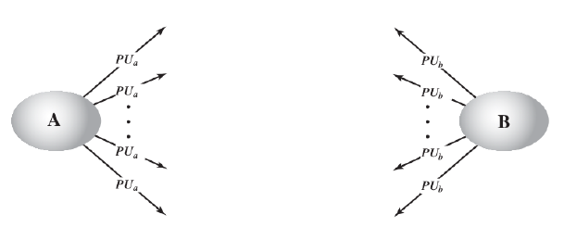
Public announcement

Slide 27
Public announcement
Although this approach is convenient, it has a major weakness.
Anyone can forge such a public announcement.
That is, some user could pretend to be user A and send a public key to another participant or broadcast such a public key.
Until such time as user A discovers the forgery and alerts other participants.
the forger is able to read all encrypted messages intended for A and can use the forged keys for authentication.

Slide 28
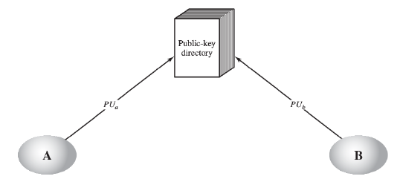
Public Available Directory

Slide 29
Public Available Directory
Maintenance and distribution of the public directory would have to be the responsibility of some trusted entity or organization
Scheme would include the following elements:
The authority maintains a directory with a {name, public key} entry for each participant.
Each participant registers a public key with the directory authority. Registration would have to be in person or by some form of secure authenticated communication.
A participant may replace the existing key with a new one at any time
Participants could also access the directory electronically

Slide 30
Public Available Directory
This scheme is clearly more secure than individual public announcements but still has vulnerabilities.
If an adversary succeeds in obtaining or computing the private key of the directory authority, the adversary could authoritatively pass out counterfeit public keys and subsequently impersonate any participant and eavesdrop on messages sent to any participant.
Another way to achieve the same end is for the adversary to tamper with the records kept by the authority.

Slide 31
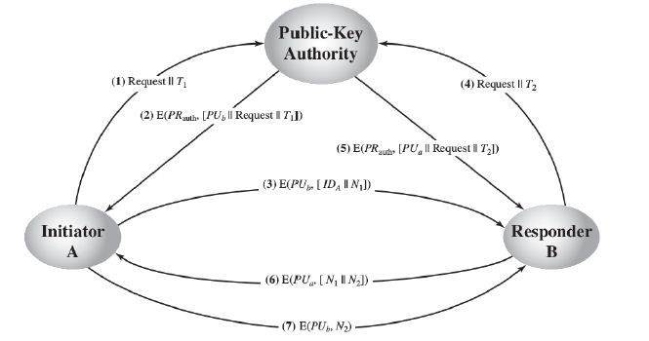
Public Key Authority

Slide 32
Public Key Authority (Scheme)
A sends a time-stamped message to the public-key authority containing a request for the current public key of B.
The authority responds with a message that is encrypted using the authority’s private key, PR auth thus, A is able to decrypt the message using the authority’s public key. Therefore, A is assured that the message originated with the authority. The message includes the following:
B’s public key, PU b , which A can use to encrypt messages destined for B
The original request used to enable A to match this response with the corresponding earlier request and to verify that the original request was not altered before reception by the authority
The original timestamp given so A can determine that this is not an old message from the authority containing a key other than B’s current public key

Slide 33
Public Key Authority (Scheme)
A stores B’s public key and also uses it to encrypt a message to B containing an identifier of A (ID A ) and a nonce (N 1 ) , which is used to identify this transaction uniquely.
B retrieves A’s public key from the authority in the same manner as A retrieved B’s public key. At this point, public keys have been securely delivered to A and B, and they may begin their protected exchange. However, two additional steps are desirable:
B sends a message to A encrypted with PU a and containing A’s nonce (N 1 ) as well as a new nonce generated by B (N2 ) . Because only B could have decrypted message (3), the presence of N1 in message (5) assures A that the correspondent is B. A returns N2 , which is encrypted using B’s public key, to assure B that its correspondent is A.

Slide 34
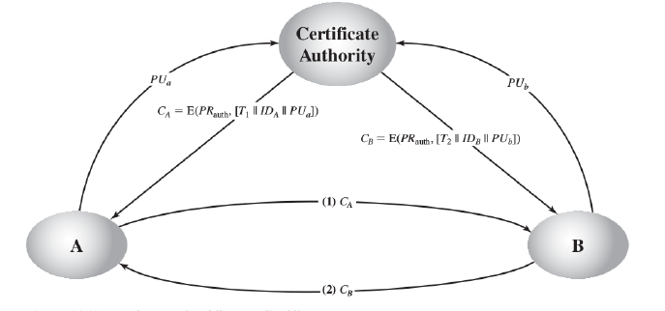
Certificate Authority

Slide 35
Certificate Authority
We can place the following requirements on this scheme:
Any participant can read a certificate to determine the name and public key of the certificate’s owner.
Any participant can verify that the certificate originated from the certificate authority and is not counterfeit.
Only the certificate authority can create and update certificates.
Any participant can verify the currency of the certificate.

